Slide 1
Hashing and Hash Tables

Slide 2
Rethinking the Search Problem
Problem
  Searching is slow if we check each element.
  Sorting helps
    Such as with binary search → O(log n)
Goal
  Constant-time lookups on average — O(1).
Think!
  Arrays give O(1) access if we know the index.
  What if we could place each item exactly where it belongs at insertion?
  This calls for a different data structure.

Slide 3
The Hash Table Idea
Many applications need a dynamic set supporting INSERT, SEARCH, and DELETE.
  Example: A compiler maintains a symbol table with keys as strings (identifiers).
Analogy: Contact list on your smartphone
  Keys: Contact names
  Values: Phone numbers
  You type a name, and instantly get the number.
Hash table works the same way
  compute a location for the key and retrieve its value directly.
A hash table generalizes an array to store (key, value) pairs for fast lookup.
Also called a map, associative array, or dictionary.
Average case: O(1) search time (worst case O(n)).

Slide 4
Direct-address tables
With an ordinary array, we store the element whose key is k at kth position of the array
This enables us to find an element whose key k is known by just looking in the kth position of the array
  This is called direct addressing
Direct addressing is applicable when we can afford to allocate an array with one position for every possible key

Slide 5
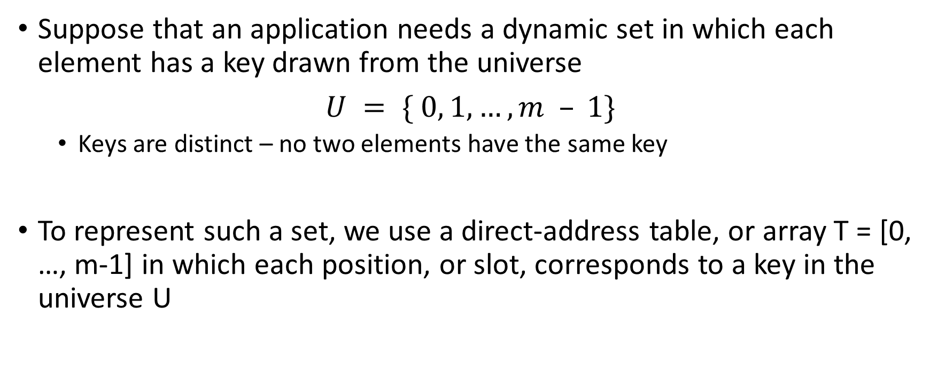
Direct addressing
Suppose that an application needs a dynamic set in which each element has a key drawn from the universe
$U = \{ 0, 1, …, m – 1\}$
  Keys are distinct – no two elements have the same key
To represent such a set, we use a direct-address table, or array T = [0, …, m-1] in which each position, or slot, corresponds to a key in the universe U

Slide 6
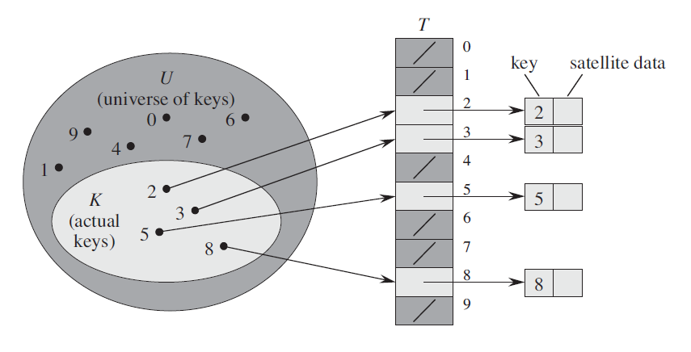
Direct address:

Slide 7
Downside of direct addressing
The downside of direct addressing is obvious:
  If the universe U is large, storing a table T of size |U| may be impractical, or even impossible, given the memory available on a typical computer
  Also, the set K of keys actually stored may be so small relative to U that most of the space allocated for T would be wasted

Slide 8
Hash Table
When the number of keys actually stored is small relative to the total number of possible keys, hash tables become an effective alternative to directly addressing an array
Reason:
  Because a hash table typically uses an array of size proportional to the number of keys actually stored
  Also, instead of using the key as an array index directly, the array index is computed from the key

Slide 9
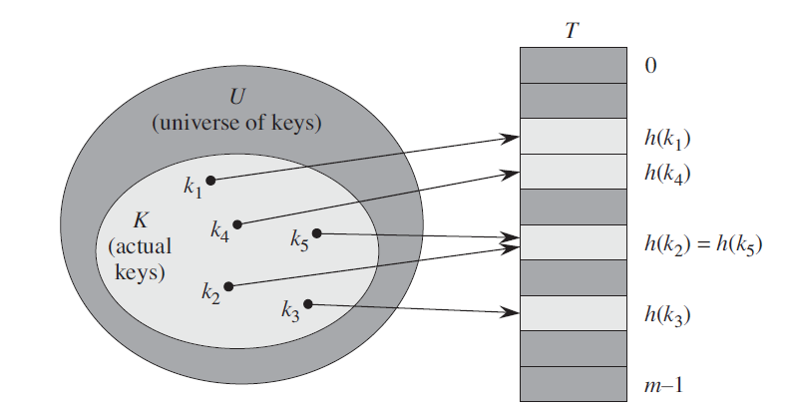
Hash Table
With direct addressing, an element with key k is stored in slot k
With hashing, this element is stored in slot h(k) i.e., we use a hash function h to compute the slot from the key k

Slide 10
Hash Table
We say that an element with key k hashes to slot h(k) or h(k) is the hash value of key k

Slide 11
Hash Table
Definition: the Hash Table data structure is merely an array of some fixed size, containing the elements
Consists of an array and a mapping function (known as hash function). A hash table is an array of size Tsize
  has index positions 0 .. Tsize-1
Used for performing insertion, deletion and lookup in constant time (on average).

Slide 12
Compared to direct addressing
Advantage: Requires less storage and runs in O(1) time.
Comparison
 | Running time | Storage
Direct Addressing | Worst time: O(1) | Store in slot k, |U| values
Hashing | Average time: O(1) | Store in slot h(k), m values

Slide 13







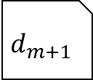
Structure of a Hash Table
A table of size m
Each record has a special field, called its key
Key_1
Key_2
Key_3
Key_4
Key_5
Key_6
…….
Key_m
$$d_{1}$$
$$d_{2}$$
$$d_{3}$$
$$d_{4}$$
$$d_{5}$$
$$d_{6}$$
$$d_{m}$$
[0]
[1]
[2]
[3]
[4]
[5]
[m-1]
The rest of the record has data
h(k)
When a hash table is in use,
some spots contain valid records, and
other spots are "empty“
$$d_{m+1}$$
To insert a new record, the key must be converted to an array index. The computed index is called the hash value of the key

Slide 14

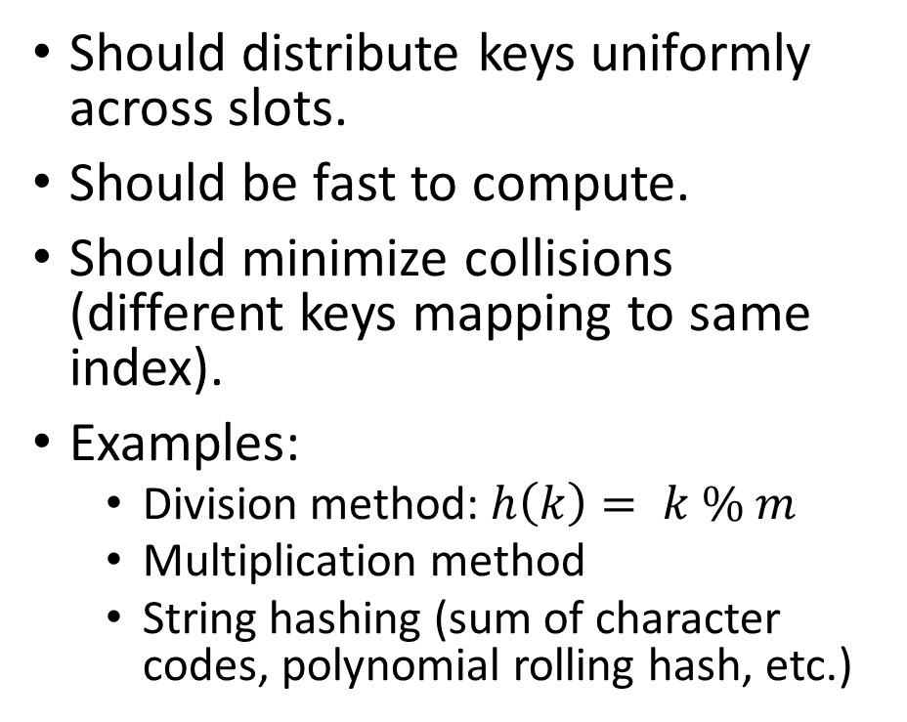


Good Hash Functions
T
$$h(90)=90\%10=0$$
Universe of Keys
90 - 99
90
Should distribute keys uniformly across slots.
Should be fast to compute.
Should minimize collisions (different keys mapping to same index).
Examples:
  Division method: $h\left(k\right)= k \% m$
  Multiplication method
  String hashing (sum of character codes, polynomial rolling hash, etc.)
95
96
92
98
$$h(k) = k\%10$$
$$h(98)=98\%10=8$$

Slide 15
Restrictions on value of m
Key | Binary | K mod 8
8 | 1000 | 0
7 | 111 | 7
12 | 1100 | 4
34 | 100010 | 2
56 | 111000 | 0
78 | 1001110 | 6
90 | 1011010 | 2
23 | 10111 | 7
45 | 101101 | 5
67 | 1000011 | 3
m should not be a power of 2
if m=2^{p} then h(k) is just the p lowest order bits of k
Disadvantage!

Slide 16
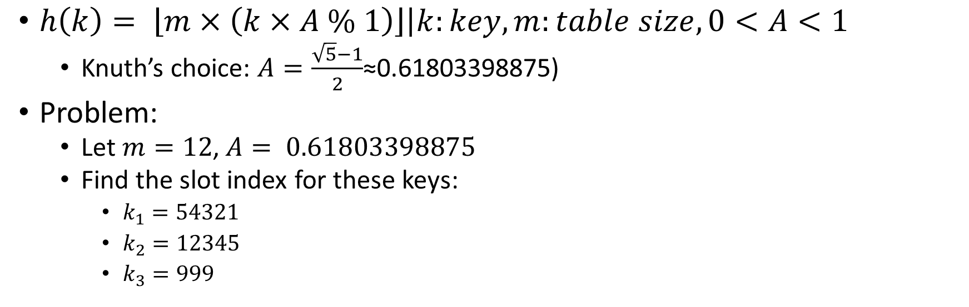
Practice: Multiplication Method
$h\left(k\right)= \left.\left\lfloor m×\left(k×A \% 1\right)\right\rfloor \right|k:key, m:table size, 0<A<1$
  Knuth’s choice: $A=\frac{\sqrt{5}−1}{2}$≈0.61803398875)
Problem:
  Let $m=12$, $A= 0.61803398875$
  Find the slot index for these keys:
    $k_{1}=54321$
    $k_{2}=12345$
    $k_{3}=999$
 |  | $$k_{1}=54321$$ |  | $$k_{3}=999$$ |  |  | $$k_{2}=12345$$

Slide 17
Restrictions on value of m
Keeping m = 2^{p} would be fine only if
  it is known that probability distribution on keys makes all lower order p-bit patterns equally likely
Otherwise
  it is better to make the hash function dependent on all the bits of the key.

Slide 18
Good value of m
Good values of m are primes not close to the exact powers of 2
  E.g., if you want to store 2000 elements then
    We don’t mind examining an average of 3 elements on unsuccessful search
  We choose m = 701 (m = hash table length) which is a prime near 2000/3 but not near power of 2 and yields a hash function as follows
h(k) = k mod 701

Slide 19

Practice: String Hashing
Letter | ASCII | Letter | ASCII | Letter | ASCII | Letter | ASCII
A | 65 | H | 72 | O | 79 | V | 86
B | 66 | I | 73 | P | 80 | W | 87
C | 67 | J | 74 | Q | 81 | X | 88
D | 68 | K | 75 | R | 82 | Y | 89
E | 69 | L | 76 | S | 83 | Z | 90
F | 70 | M | 77 | T | 84
G | 71 | N | 78 | U | 85
How?
  Convert each character to ASCII.
  Sum codes.
  Apply modulo $m$ to find slot index.
Problem
  Let $m=12$
  Find the slot index for these keys:
    "HASH"
    "CODE"
    "DATA“
Solution?
"HASH": 72 + 65 + 83 + 72 = 292, 292 mod 12 = 4
"CODE": 67 + 79 + 68 + 69 = 283, 283 mod 12 = 7
"DATA": 68 + 65 + 84 + 65 = 282, 282 mod 12 = 6

Slide 20
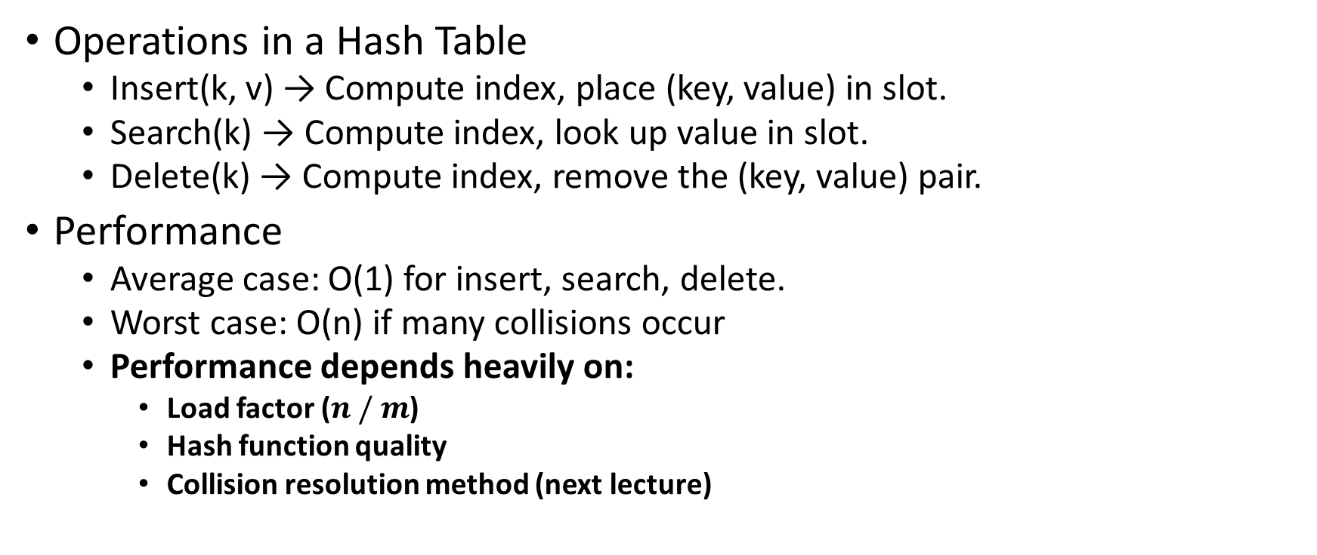
Why Hash Table?
Operations in a Hash Table
  Insert(k, v) → Compute index, place (key, value) in slot.
  Search(k) → Compute index, look up value in slot.
  Delete(k) → Compute index, remove the (key, value) pair.
Performance
  Average case: O(1) for insert, search, delete.
  Worst case: O(n) if many collisions occur
  Performance depends heavily on:
    Load factor ($n / m$)
    Hash function quality
    Collision resolution method (next lecture)

Slide 21
Collision Resolution
in HashTables

Slide 22
A New Problem!
Let’s digitize a fruit shop!
  The memory has space for 10 fruit varieties at a time.
  Throughout the year, we may encounter up to 300 unique fruit types (varieties, not quantities).
  A hash table will help us quickly store and retrieve information about each fruit type.

Slide 23
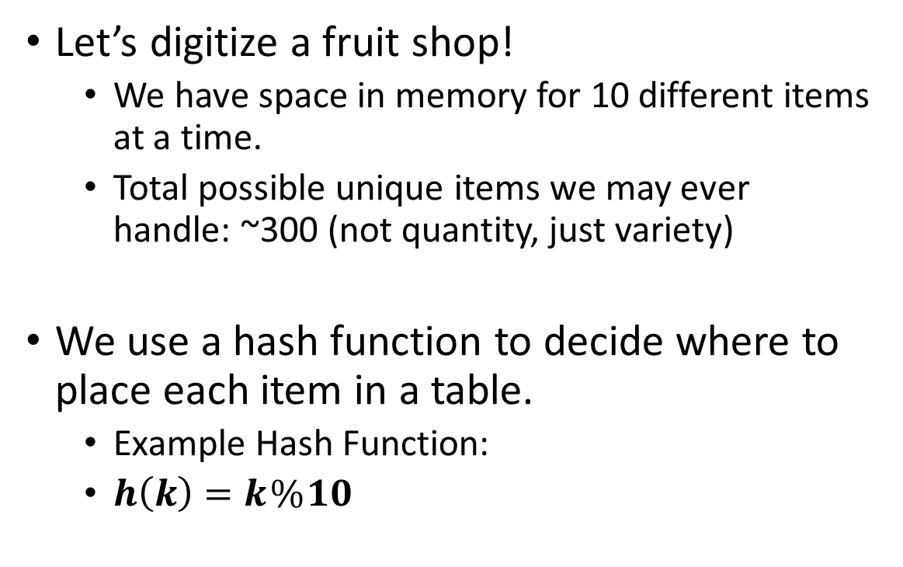
A New Problem!
Let’s digitize a fruit shop!
  We have space in memory for 10 different items at a time.
  Total possible unique items we may ever handle: ~300 (not quantity, just variety)
We use a hash function to decide where to place each item in a table.
  Example Hash Function:
  $h\left(k\right)=k \% 10$
[0]
[1]
[2]
[3]
[4]
[5]
[6]
[7]
[8]
[9]

Slide 24

A New Problem!
Hash Function:
  $h\left(k\right)=k \% 10$
Now we add:
  {85, Apple, Qty: 120} $→85 \% 10=5$
[0]
[1]
[2]
[3]
[4]
[5]
[6]
[7]
[8]
[9]
85
{85, Apple, Qty: 120}

Slide 25


A New Problem!
Hash Function:
  $h\left(k\right)=k \% 10$
Now we add:
  {85, Apple, Qty: 120} $→85 \% 10=5$
  {323, Apple, Qty: 60} $→323 \% 10=3$
[0]
[1]
[2]
[3]
[4]
[5]
[6]
[7]
[8]
[9]
$$323$$
{323, Guava, Qty: 60}
85
{85, Apple, Qty: 120}

Slide 26
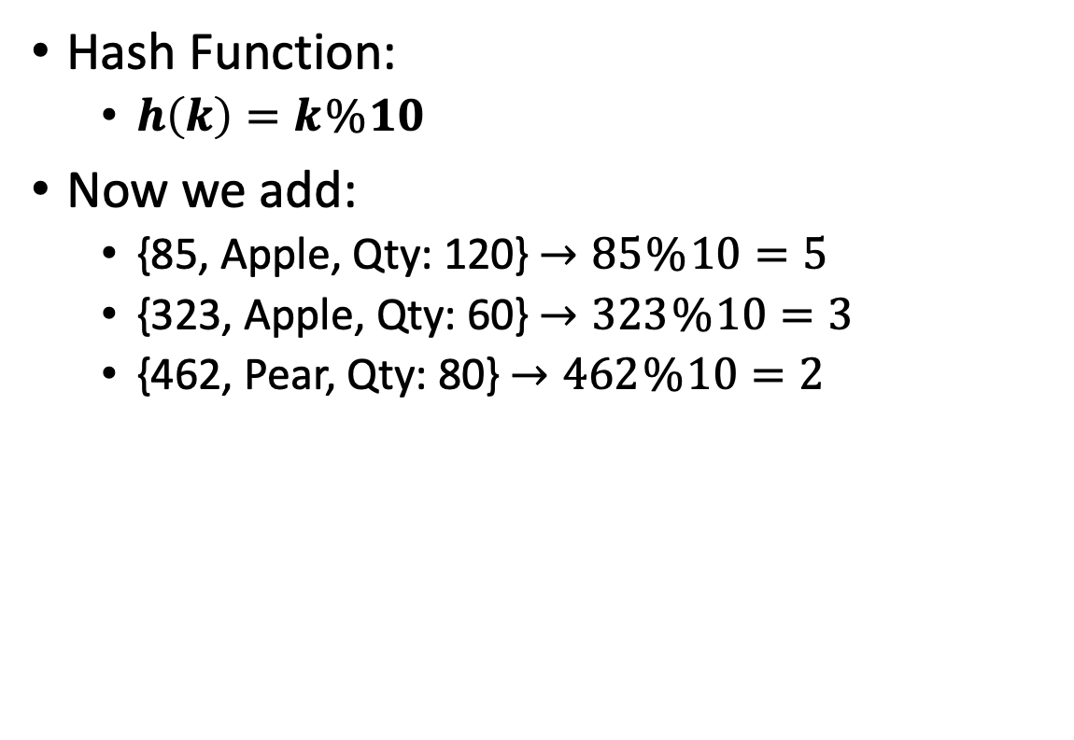

A New Problem!
Hash Function:
  $h\left(k\right)=k \% 10$
Now we add:
  {85, Apple, Qty: 120} $→85 \% 10=5$
  {323, Apple, Qty: 60} $→323 \% 10=3$
  {462, Pear, Qty: 80} $→462 \% 10=2$
[0]
[1]
[2]
[3]
[4]
[5]
[6]
[7]
[8]
[9]
$$462$$
{462, Pear, Qty: 80}
$$323$$
{323, Guava, Qty: 60}
85
{85, Apple, Qty: 120}

Slide 27
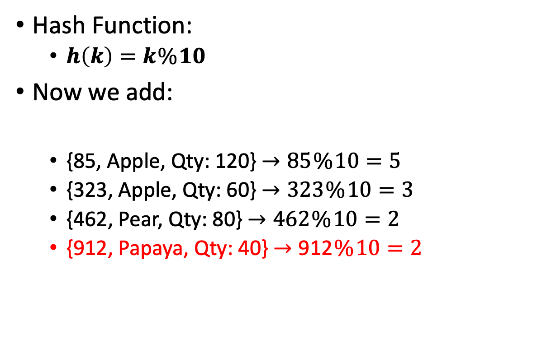

A New Problem!
Hash Function:
  $h\left(k\right)=k \% 10$
Now we add:
  {85, Apple, Qty: 120} $→85 \% 10=5$
  {323, Apple, Qty: 60} $→323 \% 10=3$
  {462, Pear, Qty: 80} $→462 \% 10=2$
  {912, Papaya, Qty: 40} $→\text{912} \% 10=2$
[0]
[1]
[2]
[3]
[4]
[5]
[6]
[7]
[8]
[9]
$$912$$
{912, Papaya, Qty: 40}
$$462$$
{462, Pear, Qty: 80}
$$323$$
{323, Guava, Qty: 60}
85
{85, Apple, Qty: 120}

Slide 28
What is a Collision?
When two different keys hash to the same table index.
Happens due to:
  Limited table size.
  Hash function producing the same value for different keys.

Slide 29
What is a Collision?
When two different keys hash to the same table index.
Happens due to:
  Limited table size.
  Hash function producing the same value for different keys.
Resolution?
  Open Addressing
    Store all elements in the table array.
    If slot is full, use a probing sequence to find the next empty slot.
  Chaining
    Each slot points to a linked list of all items that hash to it.
    Multiple items can live in the same slot, in a list.

Slide 30
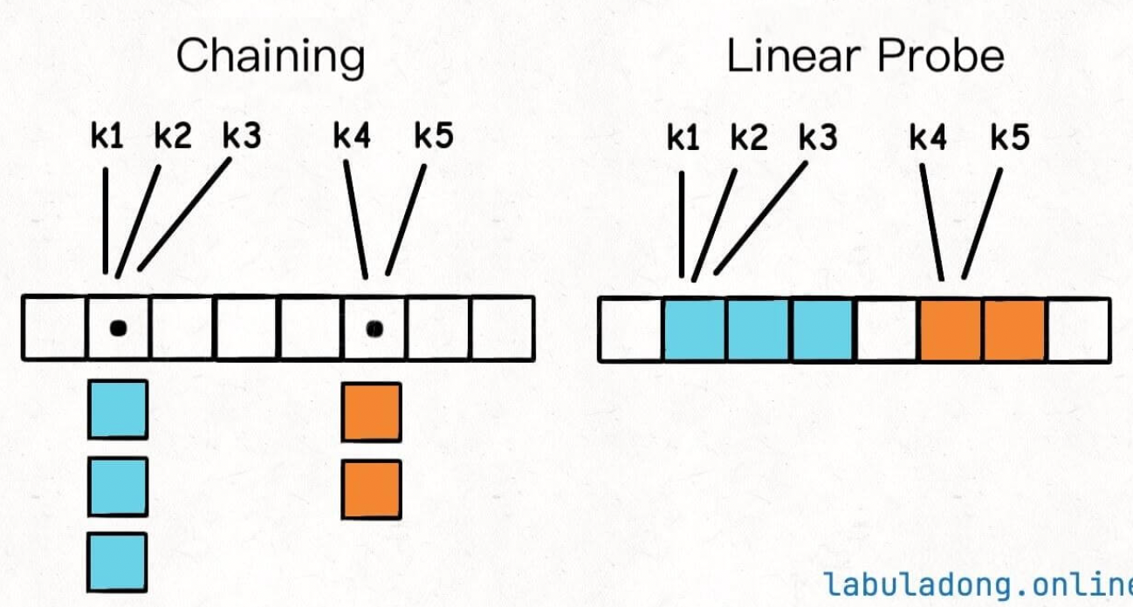
Chaining vs linear probing

Slide 31



Open Addressing
Linear Probing Example
When a collision occurs, move forward until you find an empty spot
  {462, Pear, Qty: 80} $→462 \% 10=2$
  {912, Papaya, Qty: 40} $→912 \% 10=2$
    2 is occupied
[0]
[1]
[2]
[3]
[4]
[5]
[6]
[7]
[8]
[9]
$$912$$
{912, Papaya, Qty: 40}
$$462$$
{462, Pear, Qty: 80}
$$323$$
{323, Guava, Qty: 60}
85
{85, Apple, Qty: 120}

Slide 32


Open Addressing
Linear Probing Example
When a collision occurs, move forward until you find an empty spot
  {462, Pear, Qty: 80} $→462 \% 10=2$
  {912, Papaya, Qty: 40} $→912 \% 10=2$
    2 is occupied$→$ check 3, 4,…
[0]
[1]
[2]
[3]
[4]
[5]
[6]
[7]
[8]
[9]
$$462$$
{462, Pear, Qty: 80}
$$912$$
{912, Papaya, Qty: 40}
$$323$$
{323, Guava, Qty: 60}
85
{85, Apple, Qty: 120}

Slide 33


Open Addressing
Linear Probing Example
When a collision occurs, move forward until you find an empty spot
  {462, Pear, Qty: 80} $→462 \% 10=2$
  {912, Papaya, Qty: 40} $→912 \% 10=2$
    2 is occupied$→$ check 3, 4,…
    until empty slot is found
[0]
[1]
[2]
[3]
[4]
[5]
[6]
[7]
[8]
[9]
$$462$$
{462, Pear, Qty: 80}
$$323$$
{323, Guava, Qty: 60}
$$912$$
{912, Papaya, Qty: 40}
85
{85, Apple, Qty: 120}

Slide 34

Open Addressing
Linear Probing Example
When a collision occurs, move forward until you find an empty spot
  {462, Pear, Qty: 80} $→462 \% 10=2$
  {912, Papaya, Qty: 40} $→912 \% 10=2$
    2 is occupied$→$ check 3, 4,…
    until empty slot is found
[0]
[1]
[2]
[3]
[4]
[5]
[6]
[7]
[8]
[9]
$$462$$
{462, Pear, Qty: 80}
$$323$$
{323, Guava, Qty: 60}
$$912$$
{912, Papaya, Qty: 40}
85
{85, Apple, Qty: 120}

Slide 35


Open Addressing
When searching for an empty slot, remember to wrap around (like a circular array)
Linear Probing Example
[0] | [1] | [2] | [3] | [4] | [5] | [6] | [7] | [8] | [9]
When a collision occurs, move forward until you find an empty spot
  {462, Pear, Qty: 80} $→462 \% 10=2$
  {912, Papaya, Qty: 40} $→912 \% 10=2$
    2 is occupied$→$ check 3, 4,…
    until empty slot is found
637 % 10=7
[0]
[1]
[2]
[3]
[4]
[5]
[6]
[7]
[8]
[9]
$$462$$
{462, Pear, Qty: 80}
$$323$$
{323, Guava, Qty: 60}
Pros
Cons
Simple
memory efficient.
Clustering: long runs of filled slots.
$$912$$
{912, Papaya, Qty: 40}
85
{85, Apple, Qty: 120}

Slide 36
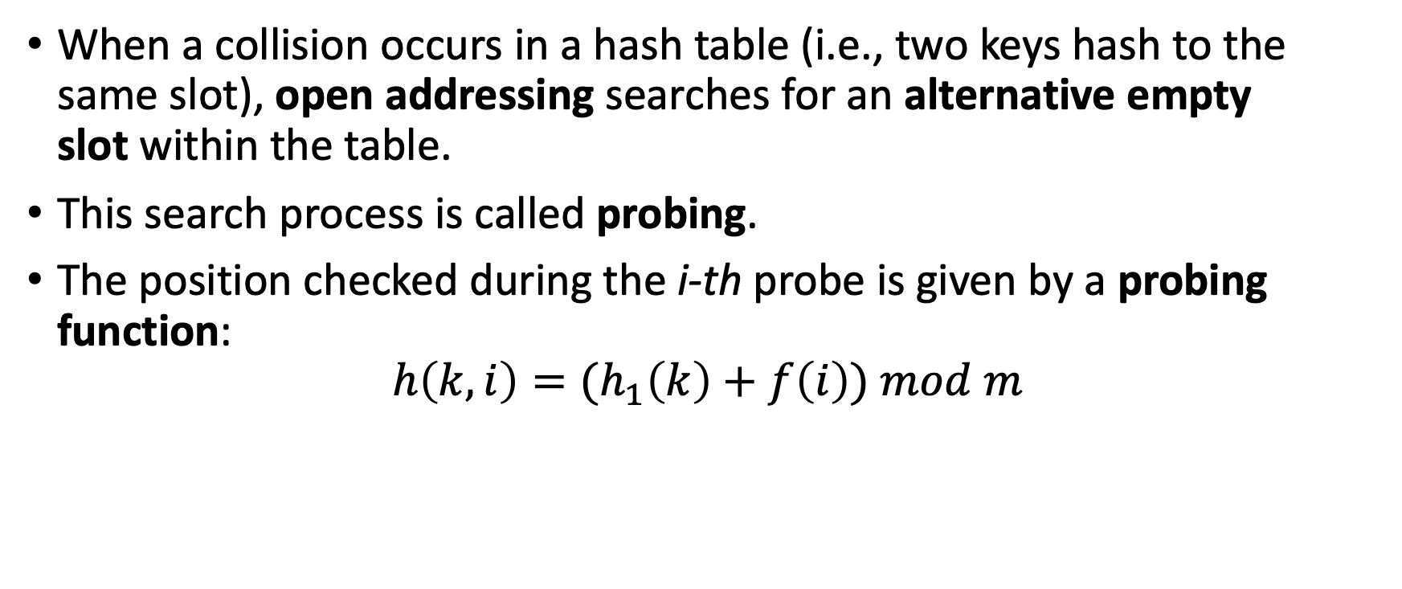
What is Probing in open addressing?
When a collision occurs in a hash table (i.e., two keys hash to the same slot), open addressing searches for an alternative empty slot within the table.
This search process is called probing.
The position checked during the i-th probe is given by a probing function:
$$h\left(k,i\right)={(h}_{1}\left(k\right)+f\left(i\right)) mod m$$
k → key
i → probe number (0,1,2,…)
f(i) → probing pattern
m → table size

Slide 37
Open addressing: Linear Probing
HASH_SEARCH(T,k)
1 i ← 0
2 repeat j ← h(k,i)
3 if T[j] = k
4 return j
5 i ← i +1
6 until T[j] = NULL or i = m
7 return NULL
$$h\left(k,i\right)={(h}_{1}\left(k\right)+i) mod m$$
$$Quadratic Probing: h\left(k,i\right)={(h}_{1}\left(k\right)+c_{1}i+ c_{2}i^{2}) mod m$$
$$Double Hashing: h\left(k,i\right)={(h}_{1}\left(k\right)+i.h_{2}(k)) mod m$$

Slide 38

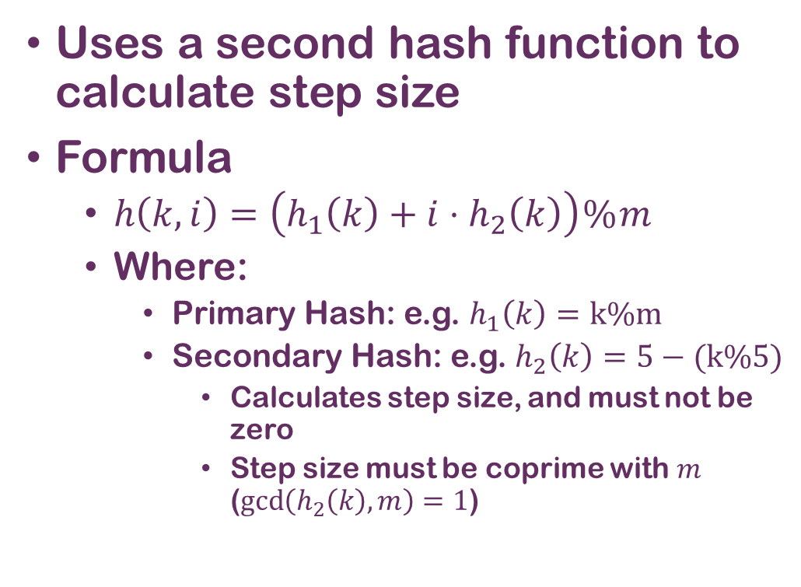
Open Addressing 2
Double Hashing
Uses a second hash function to calculate step size
Formula
  $h\left(k,i\right)=\left(h_{1}\left(k\right)+i⋅h_{2}\left(k\right)\right) \% m$
  Where:
    Primary Hash: e.g. $h_{1}\left(k\right)=k\%m$
    Secondary Hash: e.g. $h_{2}\left(k\right)=5−(k\%5)$
      Calculates step size, and must not be zero
      Step size must be coprime with $m$ ($\gcd\left(h_{2}\left(k\right),m\right)=1$)
Example
Insert {912, Papaya}
Primary Hash
  $h_{1}\left(912\right)=912\% 10=2$
    (Slot 2 occupied by pears)
Secondary Hash (Step Size)
  $h_{2}\left(912\right)=5−\left(912 \%5\right)=5−2=3$
    (coprime with 10)
Probe 1
  $\left(2+1×3\right)\%10=5$ (Check slot 5)
Probe 2 (if slot 5 is occupied)
  $\left(2+2×3\right)\%10=$8 (Check slot 8)
...1,4, 7, 0, 3, 6, 9,….

Slide 39
Chaining
Each table index stores a linked list (chain) of all keys mapping there.
On collision, new element is simply appended to the chain at that index.

Slide 40
Chaining
Each table index stores a linked list (chain) of all keys mapping there.
On collision, new element is simply appended to the chain at that index.
How?

Slide 41
Chaining
Each table index stores a linked list (chain) of all keys mapping there.
On collision, new element is simply appended to the chain at that index.
[0]
[1]
[2]
[3]
[4]
[5]
[6]
[7]
[8]
[9]
{462, Pear}
{912, Papaya}
{323, Guava}
{85, Apple}

Slide 42
Chaining
Each table index stores a linked list (chain) of all keys mapping there.
On collision, new element is simply appended to the chain at that index.
[0]
[1]
[2]
[3]
[4]
[5]
[6]
[7]
[8]
[9]
{462, Pear}
{912, Papaya}
Pros
Cons
Simple, avoids probing, table never “fills up” (only grows in chains).
Extra memory for pointers; performance drops if chains grow too long.
{323, Guava}
{85, Apple}

Slide 43
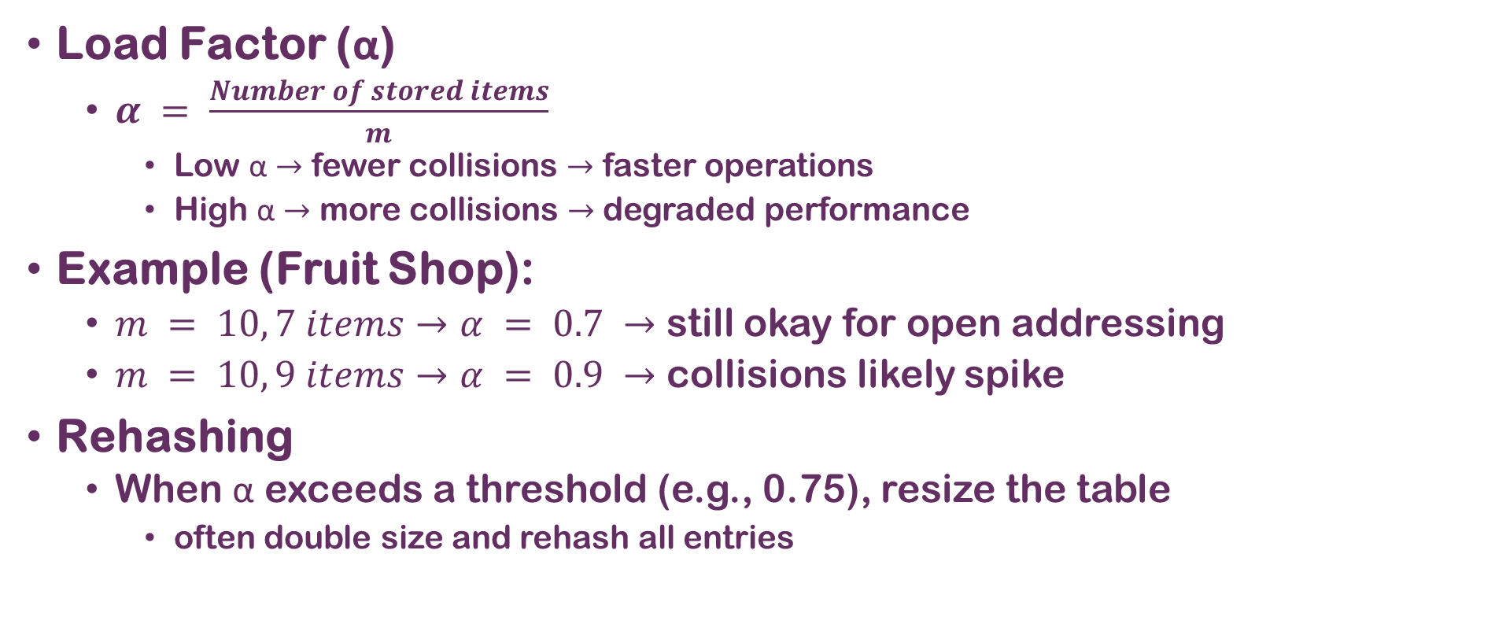
Factors Affecting Hash Table Performance
Load Factor (α)
  $α = \frac{Number of stored items}{m}$
    Low α $→$ fewer collisions $→$ faster operations
    High α $→$ more collisions $→$ degraded performance
Example (Fruit Shop):
  $m = 10, 7 items→α = 0.7 →$ still okay for open addressing
  $m = 10, 9 items→α = 0.9 →$ collisions likely spike
Rehashing
  When α exceeds a threshold (e.g., 0.75), resize the table
    often double size and rehash all entries

Slide 44
Choosing a Good Hash Function
Properties of a good hash function:
  Uniform distribution (avoids clustering)
  Fast to compute
  Minimal collisions for expected dataset
Poor choice:
  $h(k) = k \% 10$ for fruit shop
    Keys are similar (e.g., all ending in “2”)
    Clustering in the same few slots
Better choice:
  Use a prime table size (e.g. 11)
  Combine multiplication + modulo method
  For strings (fruit names), use polynomial rolling hash

Slide 45
Real-World Applications of Hash Tables
Beyond the Fruit Shop:
Databases
Compilers
Web browsers
Cybersecurity
E-commerce
Indexing tables for fast lookups
Symbol tables for identifiers
Caching DNS lookups
Password storage (with hashing + salt)
Shopping cart lookups by session ID
Notes:
A salt is a random piece of data added to a user's password before hashing it.

Slide 46
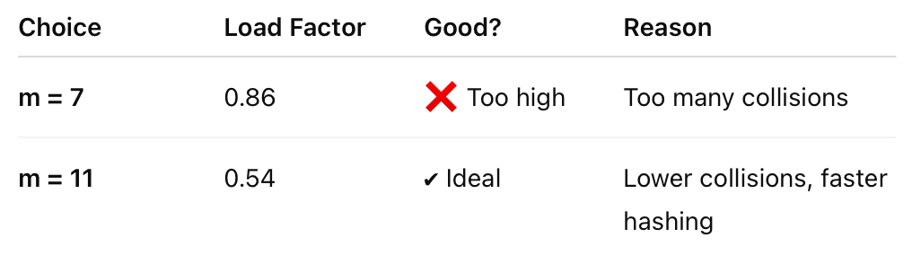
CLASSROOM ACTIVITY 1
Keys:
{29, 47, 58, 63, 91, 102}
Question:
Choose a suitable hash table size m and hash function h(k).
Explain your choice in one line.
Notes:
Choose m = 11 (prime ≥ 6 keys); use h(k) = k mod 11 to ensure good distribution and keep the load factor low (α ≈ 0.54).
M=7 is not a good choice because
α=n/m=6/7​≈0.86
α<=0.7

Slide 47
CLASSROOM ACTIVITY 2
Keys:
{12, 28, 33, 45, 57, 62}
Given:
m = 5, h(k) = k mod 5
Question:
Construct the hash table using separate chaining.
Draw each bucket’s linked list.
Key | k mod 5 | Bucket
12 | 2 | 2
28 | 3 | 3
33 | 3 | 3
45 | 0 | 0
57 | 2 | 2
62 | 2 | 2
Bucket 0: 45
Bucket 1: —
Bucket 2: 12 → 57 → 62
Bucket 3: 28 → 33
Bucket 4: —
Notes:
Separate chaining handles collisions by placing multiple keys in the same bucket as a linked list.
Because several keys hash to the same index, buckets 2 and 3 have chains.

Slide 48

CLASSROOM ACTIVITY 3
Hash Table: (already built)
Index | 0 | 1 | 2 | 3 | 4 | 5 | 6
Value | 14 | 22 | 35 | — | 49 | — | 63
Given:
h(k) = k mod 7 (linear probing)
Question:
For each key, show the probe sequence and result (FOUND or NOT FOUND):
Search 35
Search 22
Search 50
Search 63
Key | Probe Sequence | Result
35 | 0 → 1 → 2 | FOUND (index 2)
22 | 1 | FOUND (index 1)
50 | 1 → 2 → 3 | NOT FOUND
63 | 0 → 1 → 2 → 3 | NOT FOUND (even though 63 is in table)

Slide 49
CLASSROOM ACTIVITY 4
Keys:
{12, 18, 24, 30, 36, 42}
Two hash functions given:
h₁(k) = k mod 6
h₂(k) = (k × 7) mod 13
Question:
Compute bucket positions under both h₁ and h₂.
Which function distributes keys better? Explain why.
k | h₁(k)=k mod 6 | Bucket
12 | 0 | 0
18 | 0 | 0
24 | 0 | 0
30 | 0 | 0
36 | 0 | 0
42 | 0 | 0
k | 7k | h₂(k) =(7k mod 13) | Bucket
12 | 84 | 84 mod 13 = 6 | 6
18 | 126 | 126 mod 13 = 9 | 9
24 | 168 | 168 mod 13 = 12 | 12
30 | 210 | 210 mod 13 = 2 | 2
36 | 252 | 252 mod 13 = 5 | 5
42 | 294 | 294 mod 13 = 8 | 8

Slide 50

Practice: String Hashing
Letter | ASCII | Letter | ASCII | Letter | ASCII | Letter | ASCII
A | 65 | H | 72 | O | 79 | V | 86
B | 66 | I | 73 | P | 80 | W | 87
C | 67 | J | 74 | Q | 81 | X | 88
D | 68 | K | 75 | R | 82 | Y | 89
E | 69 | L | 76 | S | 83 | Z | 90
F | 70 | M | 77 | T | 84
G | 71 | N | 78 | U | 85
How?
  Convert each character to ASCII.
  Sum codes.
  Apply modulo $m$ to find slot index.
Problem
  Let $m=12$
  Find the slot index for these keys:
    "HASH"
    "CODE"
    "DATA“
Solution?
"HASH": 72 + 65 + 83 + 72 = 292, 292 mod 12 = 4
"CODE": 67 + 79 + 68 + 69 = 283, 283 mod 12 = 7
"DATA": 68 + 65 + 84 + 65 = 282, 282 mod 12 = 6

Slide 51
Keys:
{12, 18, 24, 30, 36, 42}
Two hash functions given:
h₁(k) = k mod 6
h₂(k) = (k × 7) mod 13
Question:
Compute bucket positions under both h₁ and h₂.
Which function distributes keys better? Explain why.

